Slide 1


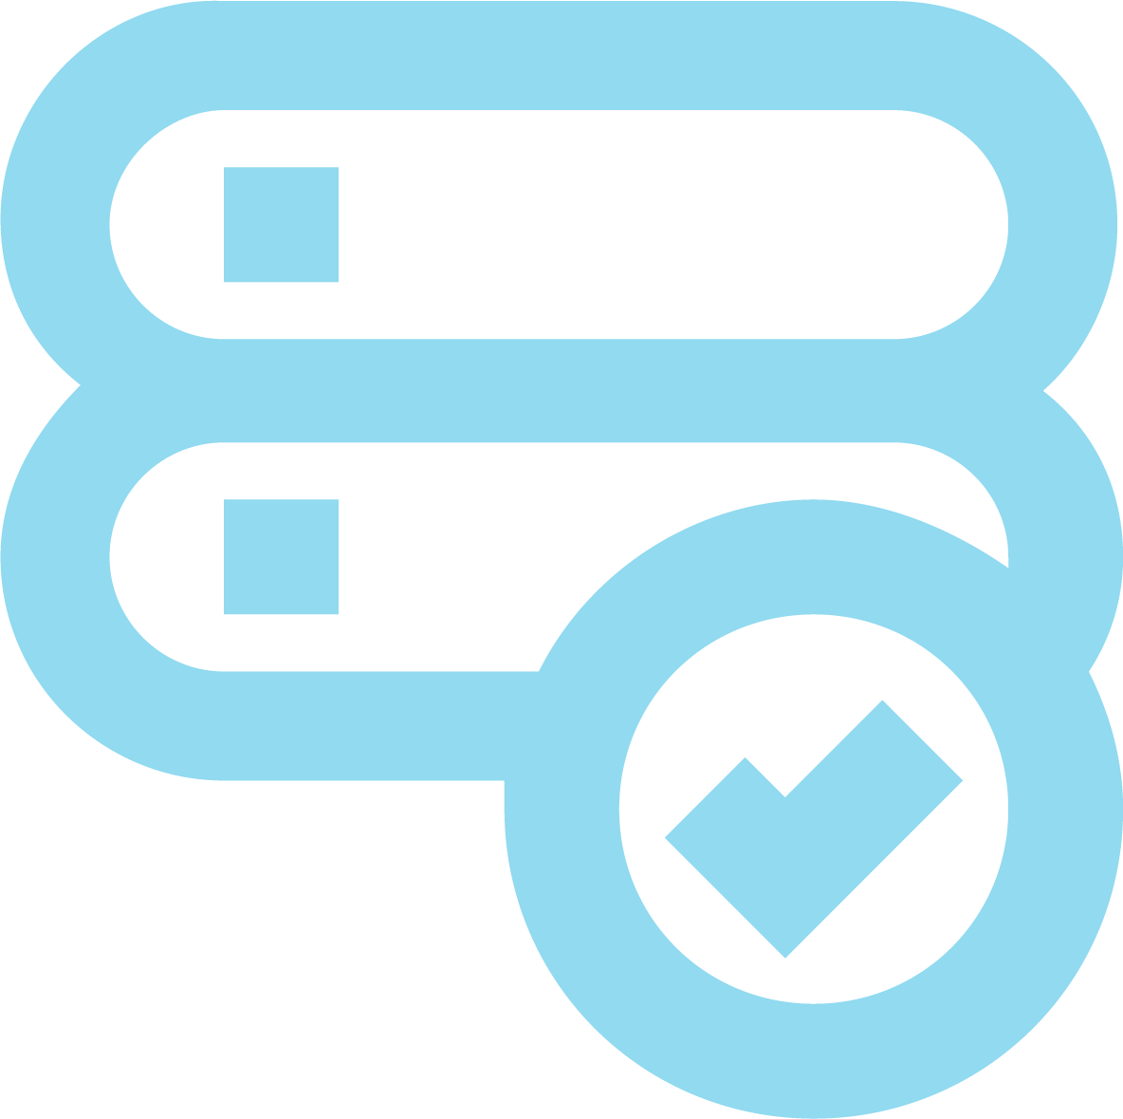
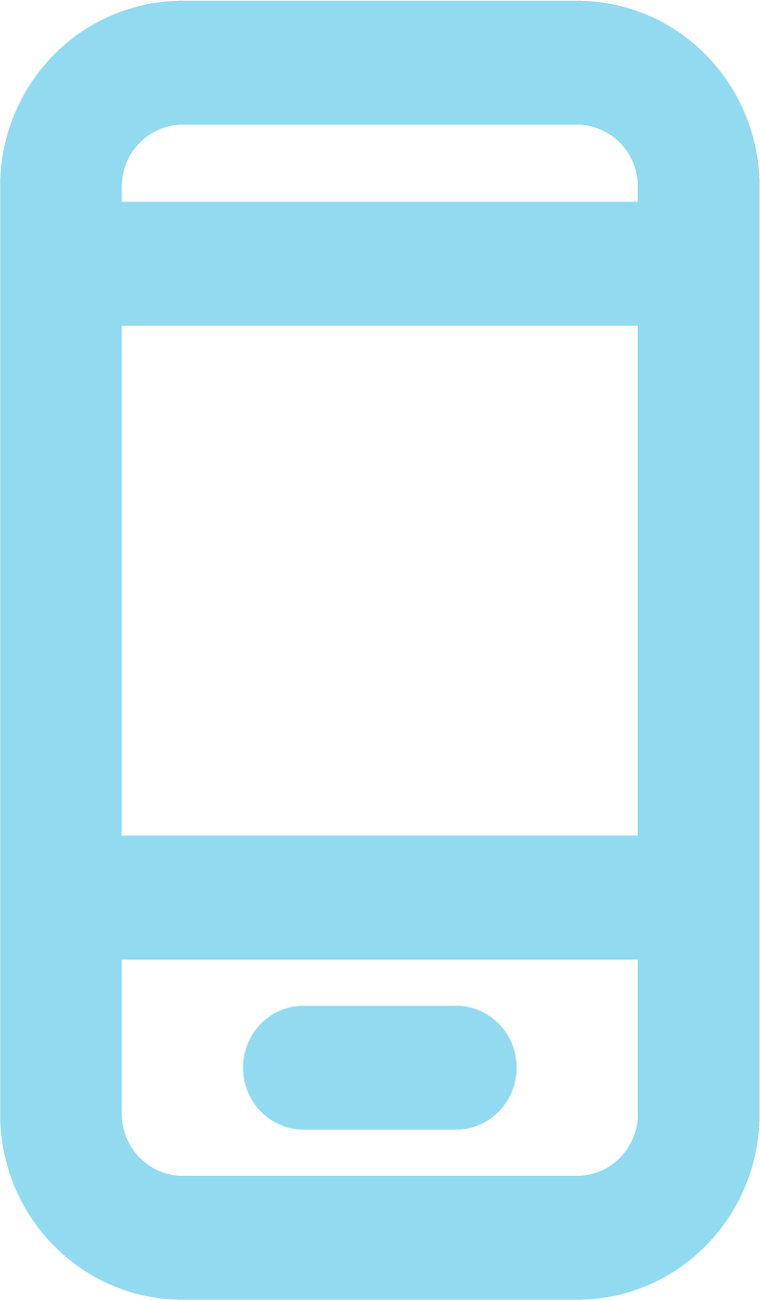
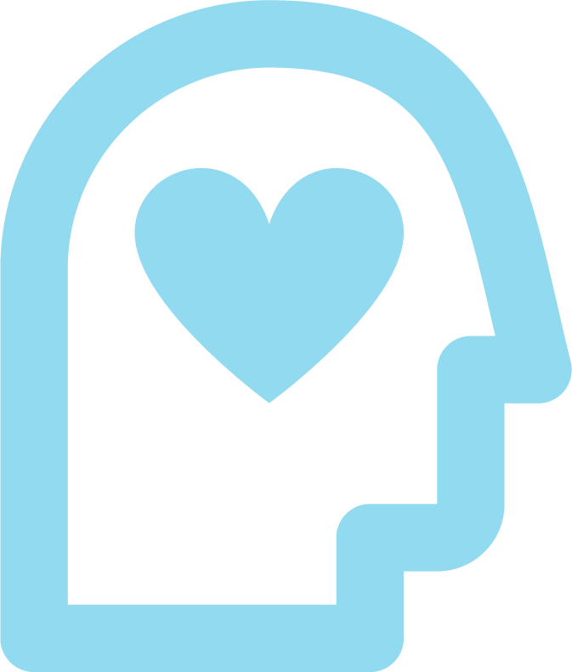
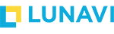
Modern Application Workshop
Build the next generation of software applications and accelerate your speed of delivery.
Digital transformation is never-ending: your applications must continually adapt to meet new business requirements and accommodate modern IT infrastructure capabilities and platforms. This modernization process can be easy in some cases and heavily involved in others. Lunavi has the Azure expertise and in-house DevOps delivery teams to help you discover the best path forward.
In our in-depth modern application workshop we will work with you build a proof-of-concept application in Azure that meets your functionality requirements to fulfill the business need, while also adopting modern, scalable underlying infrastructure.
TAKE ADVANTAGE OF CLOUD
MODERNIZE UNDERLYING INFRASTRUCTURE
Go beyond “lift and shift” by refactoring your apps to natively run on cloud platforms, reduce your overall cloud spend, and introduce opportunities for automation.
If you’re due for a hardware refresh or struggling with aging infrastructure, it’s the perfect time to migrate your apps and redesign them for the latest technology.
EMBRACE HYBRID
& MOBILE
IMPROVE THE USER EXPERIENCE
Custom app development can help your apps talk to each other and work across a wide array of platforms and endpoints, facilitating mobile workforce and enabling true hybrid deployments.
Your users, whether they are customers or employees, expect self-service, mobile compatibility, and 100% uptime and availability. An application refresh can help you effectively achieve these goals.
www.lunavi.com
© 2020 Lunavi. All Rights Reserved.

